Slide 1
Lecture 2: Mixed-effects models
April 3, 2018

Slide 2
How do we estimate things?
Specify a model
Function generating predictions
Identify plausible values for any unknown parameters
Maximize probability of observations given function
Assess uncertainty
Explore function around plausible values

Slide 3
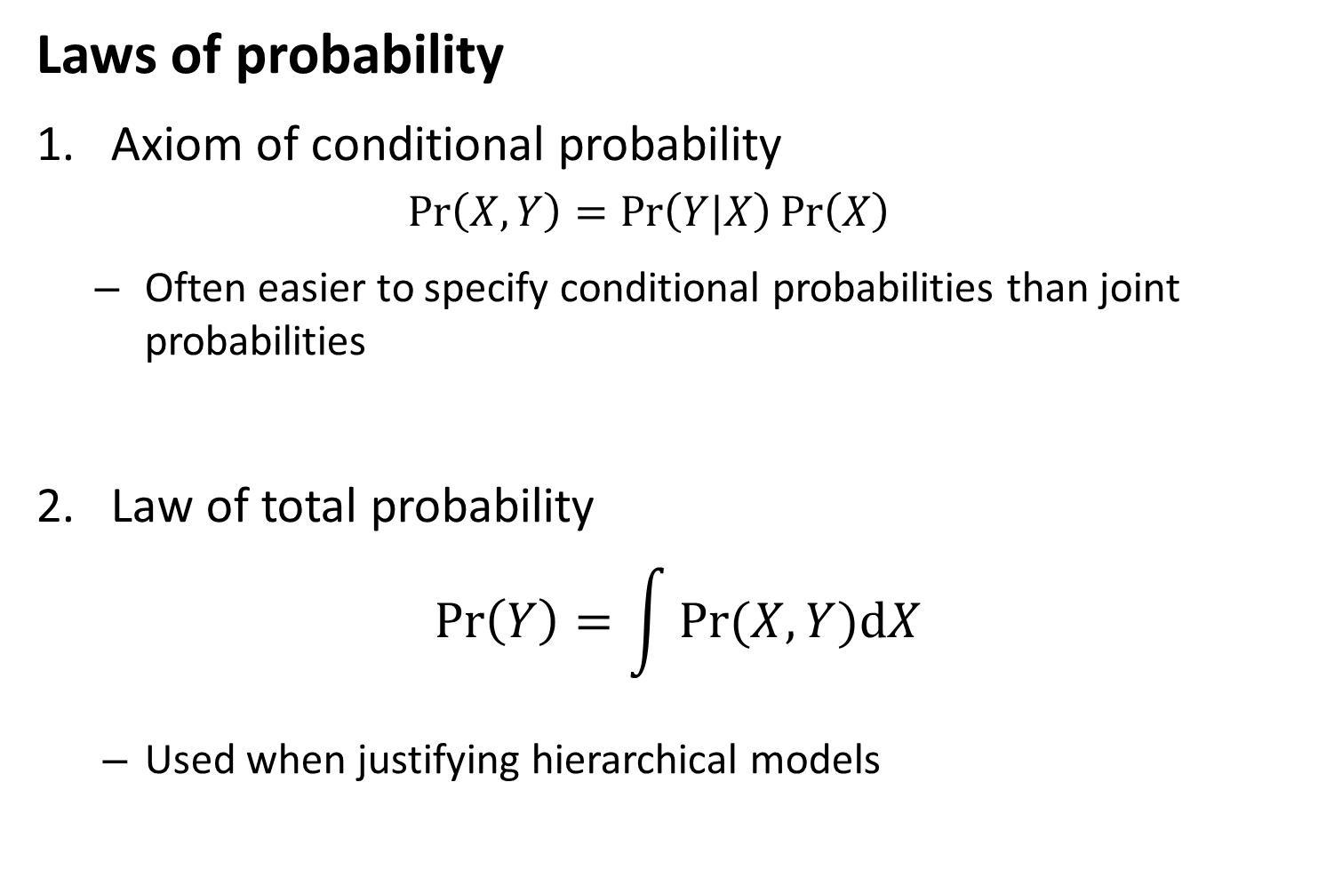
Laws of probability
Axiom of conditional probability
$$\operatorname{Pr}\left(X,Y\right)=\operatorname{Pr}\left(Y|X\right)\operatorname{Pr}\left(X\right)$$
Often easier to specify conditional probabilities than joint probabilities
Law of total probability
$$\operatorname{Pr}\left(Y\right)=\int{Pr⁡(X,Y)dX}$$
Used when justifying hierarchical models
Notes:
Intuition for conditional probability? Factorizing into a smaller set (factor a process into smaller pieces)
Small pieces to big thing
Big thing to small pieces
If we only care about one variable, we can just integrate out the other variables
Pr(X,Y)dX = Pr(Y|X)Pr(X)dX

Slide 4
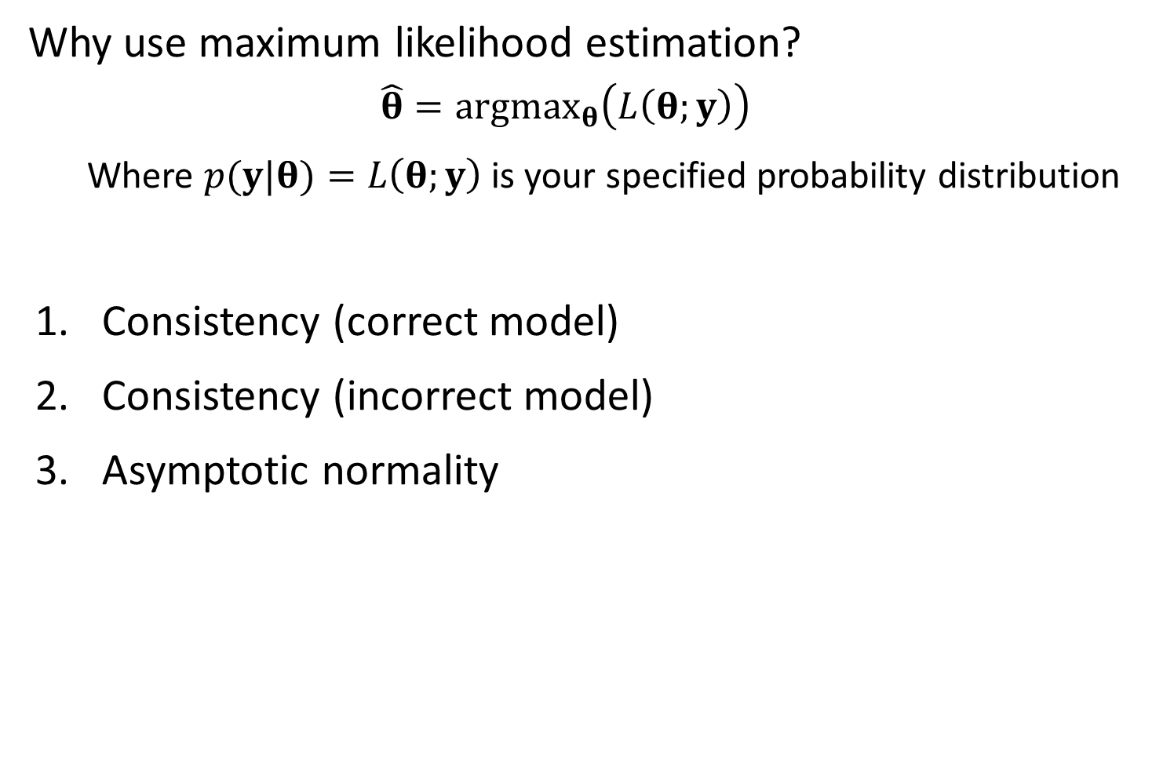
Why use maximum likelihood estimation?
$$\hat{θ}=argmax_{θ}\left(L\left(θ;y\right)\right)$$
Where $p(y|θ)=L\left(θ;y\right)$ is your specified probability distribution
Consistency (correct model)
Consistency (incorrect model)
Asymptotic normality
Notes:
Consistency of correct model matters for simulation studies (because realistically we never have the correct model)

Slide 5
Likelihood statistics
Problem:
We often can’t write the probability of data given parameters
Examples:
Tag-recapture
What’s the probability of tagging an animal in 2008, seeing it again in 2010 and 2011, and then never seeing it again?
Time-series
What’s the probability distribution for escapement of chinook salmon in the snake river in 2011, given that you’ve sampled escapement from 1980-2010?
Occupancy
Three volunteers look for an endangered butterfly at a site, and only two find it. These volunteers sample at a new site, and none see the butterfly. What is the probability that is present but wasn’t detected?
Notes:
Issue is breaking the “events” down. Not just P(occupied) but P(occupied in 1980 | occupied in 2011)
Word problems to factor joint probability distributions into conditional probabilities

Slide 6
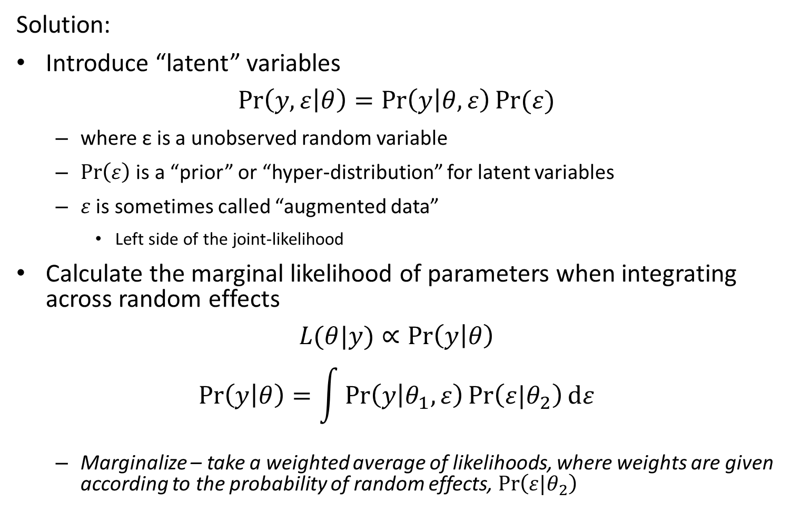
Likelihood statistics
Solution:
Introduce “latent” variables
$$\operatorname{Pr}\left(y,ε | θ\right)=\operatorname{Pr}\left(y | θ,ε\right)Pr⁡(ε)$$
where ε is a unobserved random variable
$\operatorname{Pr}\left(ε\right)$ is a “prior” or “hyper-distribution” for latent variables
$ε$ is sometimes called “augmented data”
Left side of the joint-likelihood
Calculate the marginal likelihood of parameters when integrating across random effects
$$L(θ|y)∝\operatorname{Pr}\left(y | θ\right)$$
$$\operatorname{Pr}\left(y | θ\right)=\int{\operatorname{Pr}\left(y | θ_{1},ε\right)\operatorname{Pr}\left(ε|θ_{2}\right)dε}$$
Marginalize – take a weighted average of likelihoods, where weights are given according to the probability of random effects, $\operatorname{Pr}\left(ε|θ_{2}\right)$
Notes:
Add random effects/augmented data so we can make statements about joint probabilities

Slide 7
Definitions
Term | Definition
Random effect | Coefficient that is “exchangeable” with one or more other coefficients
Hyperdistribution | Distribution for “exchangeable” random effects
Exchangeable | No information is available to distinguish between residual variability in random effects
Fixed effect | Coefficient that is not exchangeable with others, and which hence is estimated without a hyperdistribution
Mixed-effect model | Model with both fixed and random effects

Slide 8
Likelihood statistics
Why would you make a hierarchy of parameters
Biological intuition – Formulate models based on knowledge of constituent parts (Burnham and Anderson 2008)
Variance partitioning – Separate different sources of variability (e.g., measurement errors!)
Shrinkage – Often improve precision from assuming parameters arise from a distribution
Notes:
Hierarchical model == mixed effects model

Slide 9
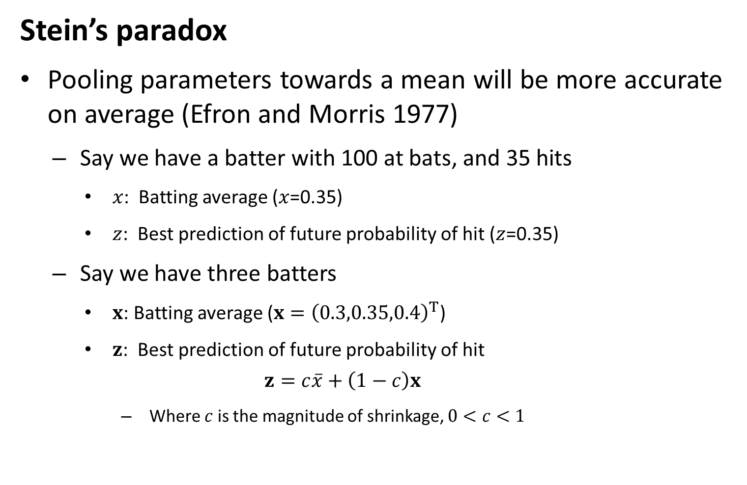
Likelihood statistics
Stein’s paradox
Pooling parameters towards a mean will be more accurate on average (Efron and Morris 1977)
Say we have a batter with 100 at bats, and 35 hits
$x$: Batting average ($x$=0.35)
$z$: Best prediction of future probability of hit ($z$=0.35)
Say we have three batters
$x$: Batting average ($x={\left(0.3,0.35,0.4\right)}^{T}$)
$z$: Best prediction of future probability of hit
$$z=c\overline{x}+\left(1−c\right)x$$
Where $c$ is the magnitude of shrinkage, $0<c<1$
Notes:
Bottom thing called pooling or shrinkage

Slide 10
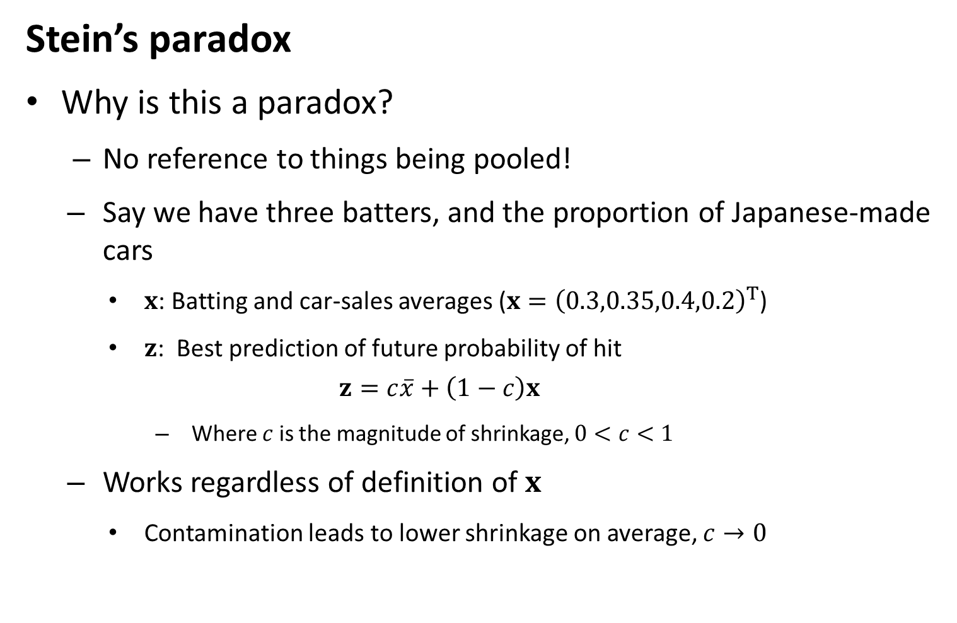
Likelihood statistics
Stein’s paradox
Why is this a paradox?
No reference to things being pooled!
Say we have three batters, and the proportion of Japanese-made cars
$x$: Batting and car-sales averages ($x={\left(0.3,0.35,0.4,0.2\right)}^{T}$)
$z$: Best prediction of future probability of hit
$$z=c\overline{x}+\left(1−c\right)x$$
Where $c$ is the magnitude of shrinkage, $0<c<1$
Works regardless of definition of $x$
Contamination leads to lower shrinkage on average, $c→0$

Slide 11
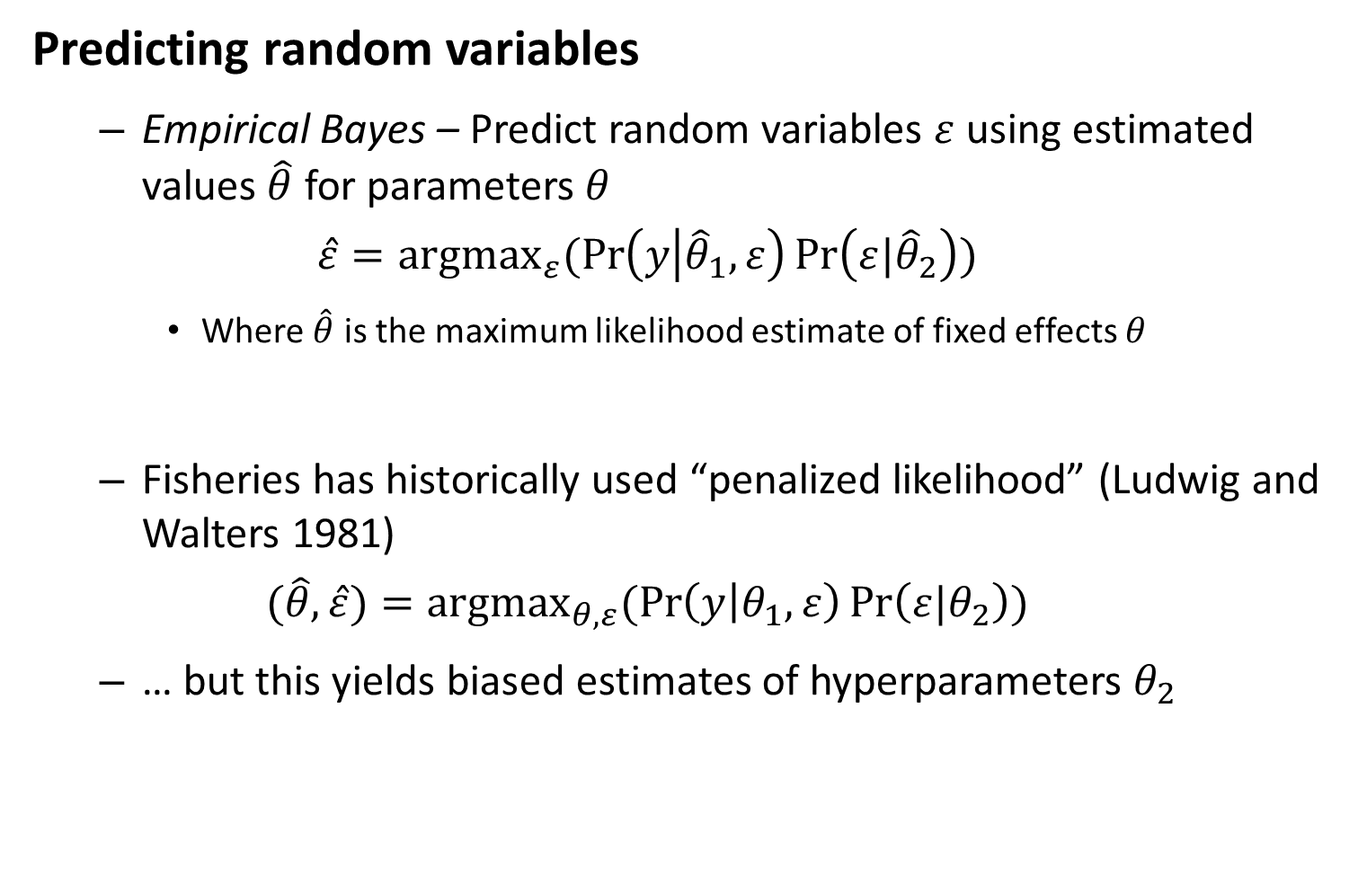
Likelihood statistics
Predicting random variables
Empirical Bayes – Predict random variables $ε$ using estimated values $\hat{θ}$ for parameters $θ$
$$\hat{ε}={argmax}_{ε}(\operatorname{Pr}\left(y | {\hat{θ}}_{1},ε\right)\operatorname{Pr}\left(ε|{\hat{θ}}_{2}\right))$$
Where $\hat{θ}$ is the maximum likelihood estimate of fixed effects $θ$
Fisheries has historically used “penalized likelihood” (Ludwig and Walters 1981)
$$(\hat{θ},\hat{ε})={argmax}_{θ,ε}(\operatorname{Pr}\left(y | θ_{1},ε\right)\operatorname{Pr}\left(ε|θ_{2}\right))$$
… but this yields biased estimates of hyperparameters $θ_{2}$
Notes:
James-Stein is one of the ways that people derived mixed effects model and Shrinkage estimator

Slide 12
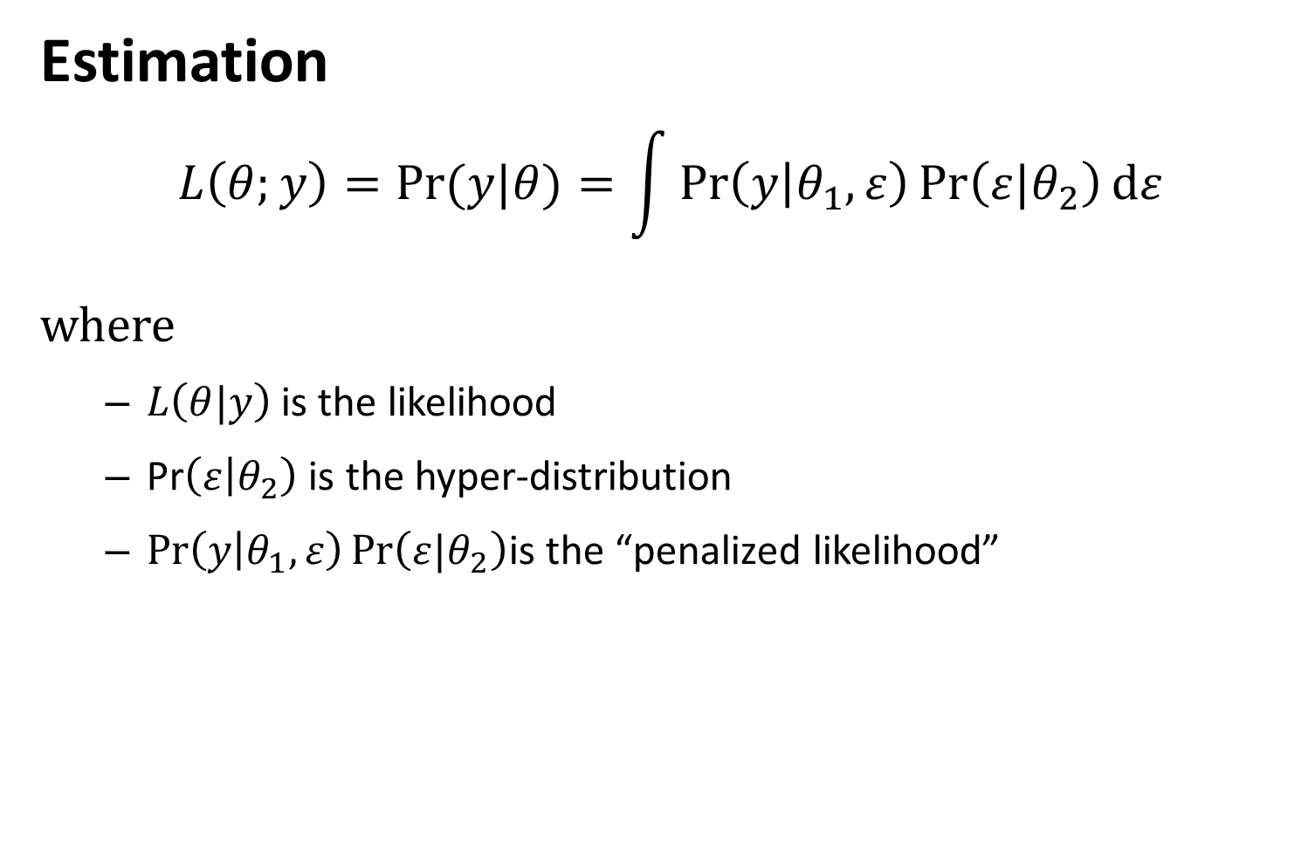
Likelihood statistics
Estimation
$$L\left(θ;y\right)=Pr⁡(y|θ)=\int{\operatorname{Pr}\left(y | θ_{1},ε\right)\operatorname{Pr}\left(ε|θ_{2}\right)dε}$$
where
$L\left(θ|y\right)$ is the likelihood
Pr$\left(ε | θ_{2}\right)$ is the hyper-distribution
$\operatorname{Pr}\left(y | θ_{1},ε\right)\operatorname{Pr}\left(ε|θ_{2}\right)$is the “penalized likelihood”

Slide 13
How do we estimate the marginal likelihood?
“Hierarchical Bayes”
Generally involves MCMC
Already integrating across parameters, so integrates across latent variables automatically
“Maximum marginal likelihood”
Use the “Laplace approximation” to approximate integral
Use alternating estimation of fixed and random effects
“Inner optimization” – Optimize random effects given fixed effects
“Outer optimization” – Optimize fixed effects given random effects

Slide 14
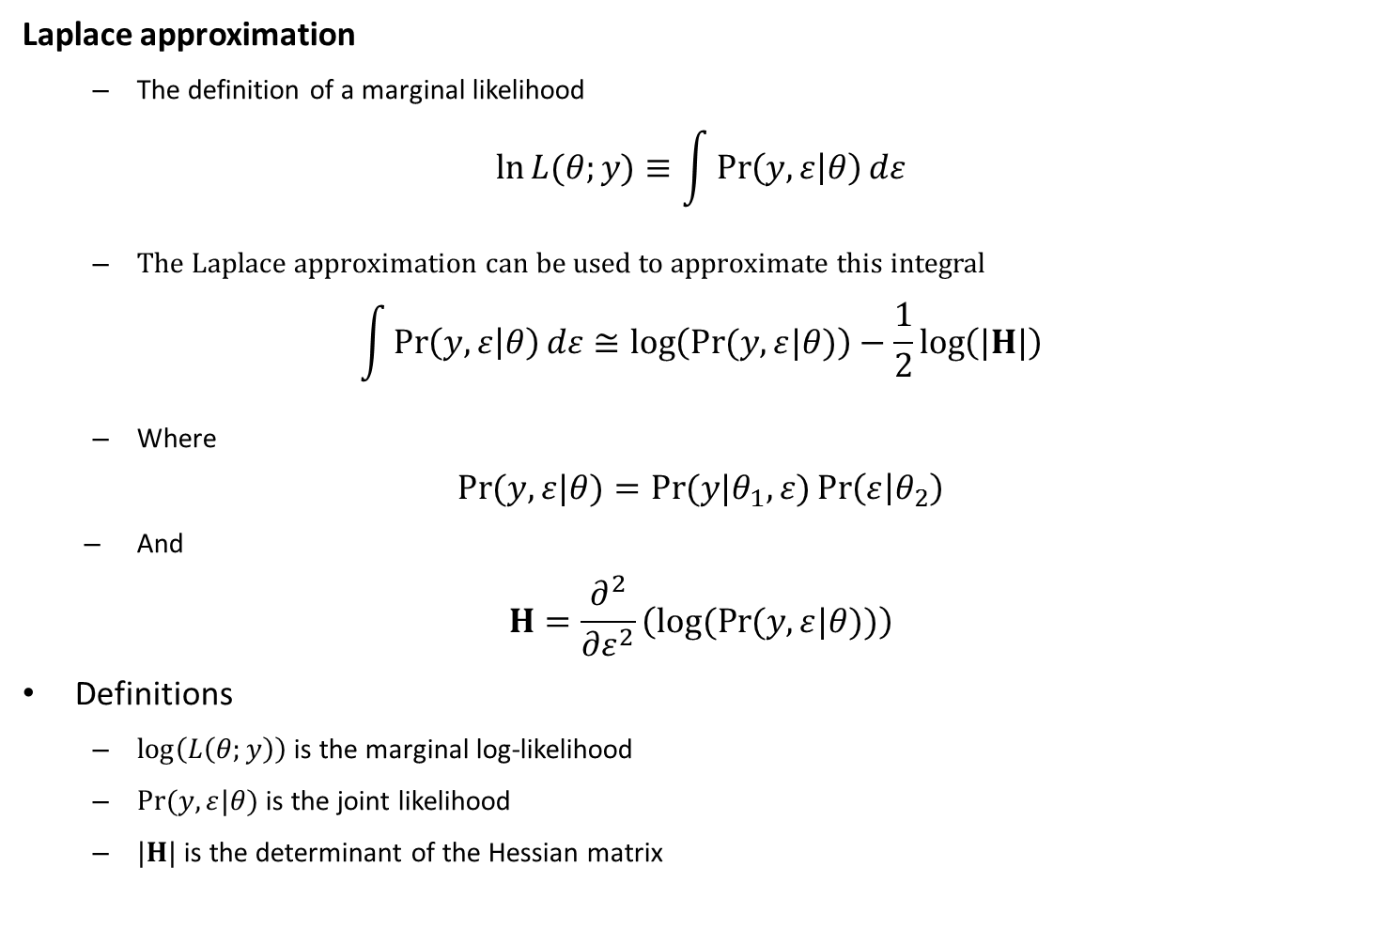
Likelihood statistics
Laplace approximation
The definition of a marginal likelihood
$$\ln{L{(θ;y)}}≡\int{\operatorname{Pr}\left(y,ε | θ\right)dε}$$
The Laplace approximation can be used to approximate this integral
$$\int{\operatorname{Pr}\left(y,ε | θ\right)dε}≅\log\left(\operatorname{Pr}{(y,ε|θ)}\right)−\frac{1}{2}\log\left(|H|\right)$$
Where
$$\operatorname{Pr}{(y,ε|θ)}=\operatorname{Pr}{(y|θ_{1},ε)}\operatorname{Pr}\left(ε | θ_{2}\right)$$
And
$$H=\frac{∂^{2}}{∂ε^{2}}\left(log(Pr{(y,ε|θ))}\right)$$
Definitions
$\log\left(L\left(θ;y\right)\right)$ is the marginal log-likelihood
$\operatorname{Pr}{(y,ε|θ)}$ is the joint likelihood
$|H|$ is the determinant of the Hessian matrix
Notes:
Integrals are hard, this is hwy these are hard
But we can approximate the probability by subtracting half the log of the determinant of the hessian matrix

Slide 15
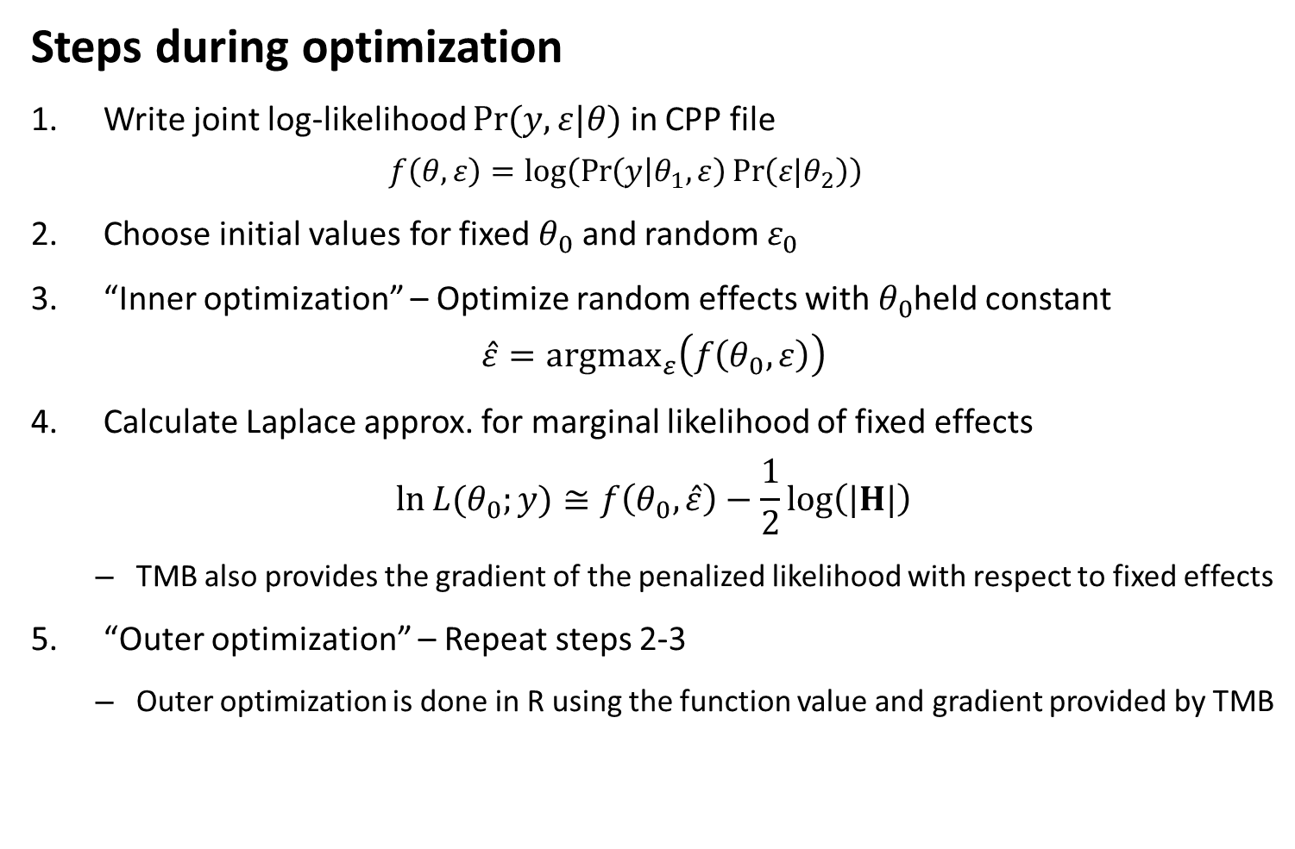
TMB
Steps during optimization
Write joint log-likelihood $\operatorname{Pr}{(y,ε|θ)}$ in CPP file
$$f\left(θ,ε\right)=log⁡\left(\operatorname{Pr}\left(y | θ_{1},ε\right)\operatorname{Pr}\left(ε|θ_{2}\right)\right)$$
Choose initial values for fixed $θ_{0}$ and random $ε_{0}$
“Inner optimization” – Optimize random effects with $θ_{0}$held constant
$$\hat{ε}={argmax}_{ε}\left(f\left(θ_{0},ε\right)\right)$$
Calculate Laplace approx. for marginal likelihood of fixed effects
$$\ln{L{(θ_{0};y)}}≅f\left(θ_{0},\hat{ε}\right)−\frac{1}{2}\log\left(|H|\right)$$
TMB also provides the gradient of the penalized likelihood with respect to fixed effects
“Outer optimization” – Repeat steps 2-3
Outer optimization is done in R using the function value and gradient provided by TMB
Notes:
Loglikehilood is now prob of data and prob of “augmented data”
Inner optimization—max wrt random effects
Outer approximation—max wrt the fixed effects
Then iterate between the two

Slide 16
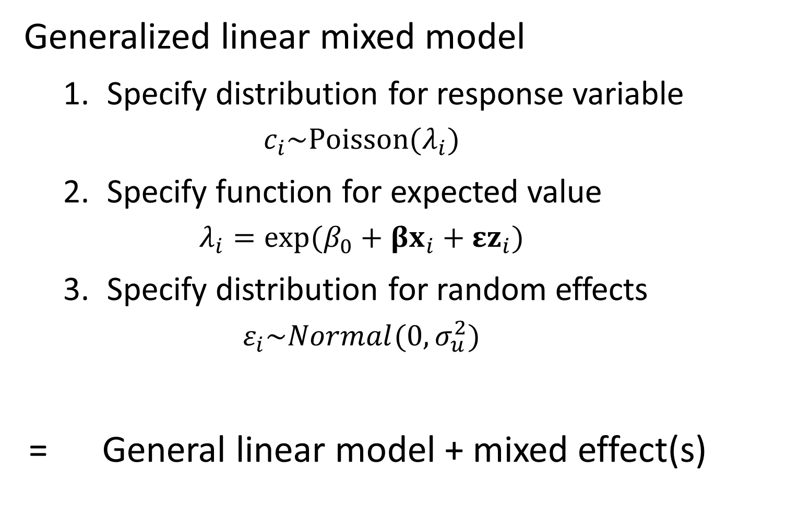
Generalized linear mixed model
Specify distribution for response variable
$$c_{i}\sim Poisson(λ_{i})$$
Specify function for expected value
$$λ_{i}=exp⁡(β_{0}+βx_{i}+εz_{i})$$
Specify distribution for random effects
$$ε_{i}\sim Normal(0,σ_{u}^{2})$$
= General linear model + mixed effect(s)

Slide 17
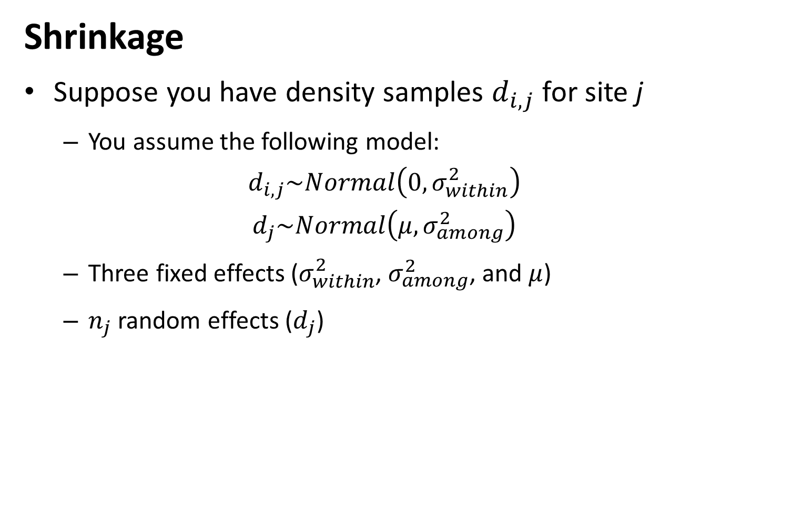
Shrinkage
Suppose you have density samples $d_{i,j}$ for site j
You assume the following model:
$$d_{i,j}\sim Normal\left(0,σ_{within}^{2}\right)$$
$$d_{j}\sim Normal\left(μ,σ_{among}^{2}\right)$$
Three fixed effects ($σ_{within}^{2}$, $σ_{among}^{2}$, and $μ$)
$n_{j}$ random effects ($d_{j}$)
Notes:
James-Stein estimator is one of the ways that people derived mixed effects model and Shrinkage estimator

Slide 18

Shrinkage
Estimated random effects are weighted average of:
Optimal predictor
$${\hat{d}}_{j}=c\overline{d}+(1−c){\overline{d}}_{j}$$
Where
$$c=\frac{{\hat{w}}_{1}}{{\hat{w}}_{1}+{\hat{w}}_{2,j}}$$
$${\hat{w}}_{1}=\frac{1}{σ_{among}^{2}}$$
$${\hat{w}}_{2}=\frac{n_{j}}{σ_{within}^{2}}$$
And where
$σ_{among}^{2}$ is the variance in $d_{j}$ among groups
$σ_{within}^{2}$ is the variance of density samples within a given group
${\overline{d}}_{j}$ is the sample mean for group j
$\overline{d}$ is the sample mean for ${\overline{d}}_{j}$ for all groups
Notes:
W are precisions (inverse variances)
If we knew the variances exactly, we oculd just plug into the formula. Otherwise estimate from data and use the shrinkage estimate, which will do better than the individual mean.
Do better means….smaller RMSE??

Slide 19
[Look at code]

